Slide 1

Pet finder
Pham Quang Hieu

Slide 2

Agenda
Description
Introduction
Dataset
Metric
Analysis
Tabular data
Image
Text
JSON file
Model & results
Model
Evaluation
Result

Slide 3
DESCRIPTION

Slide 4

https://www.petfinder.my/

Slide 5
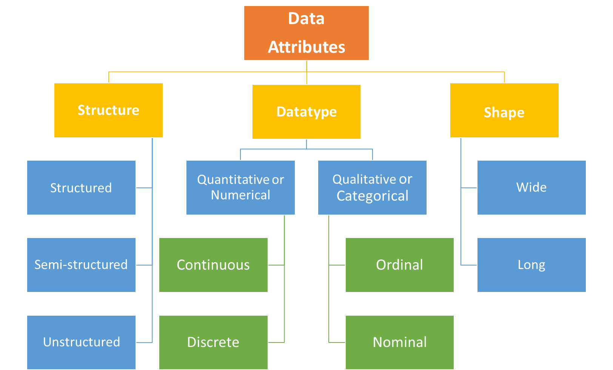
Data type

Slide 6
METRIC

Slide 7
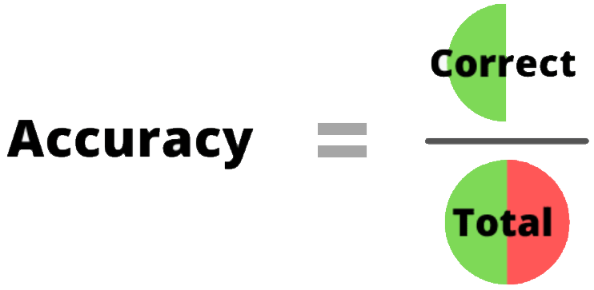
Accuracy

Slide 8
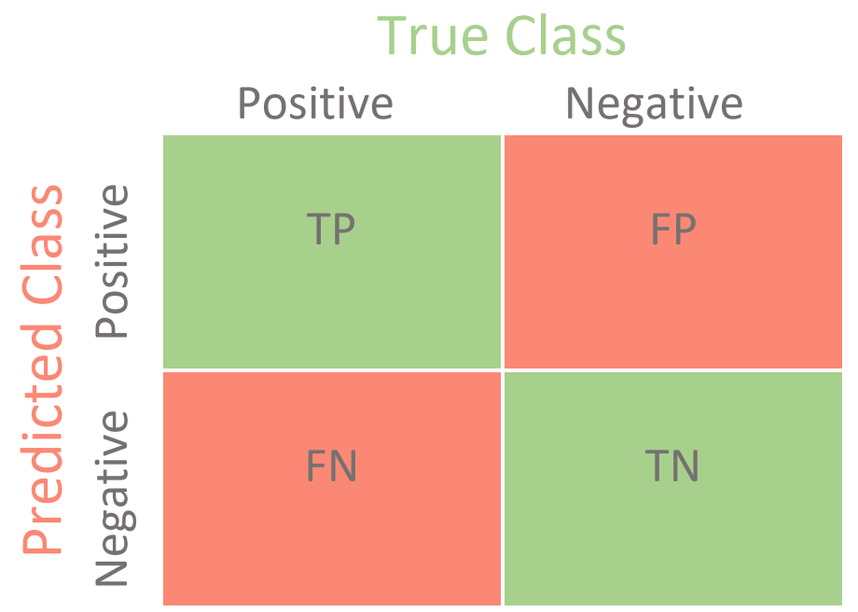
Confustion matrix

Slide 9
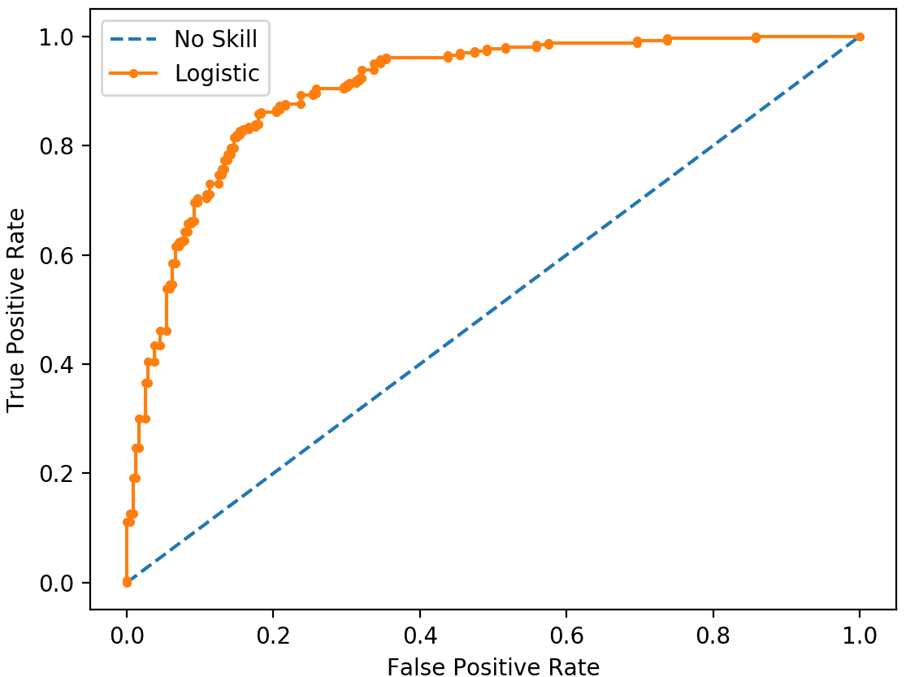
ROC curve

Slide 10
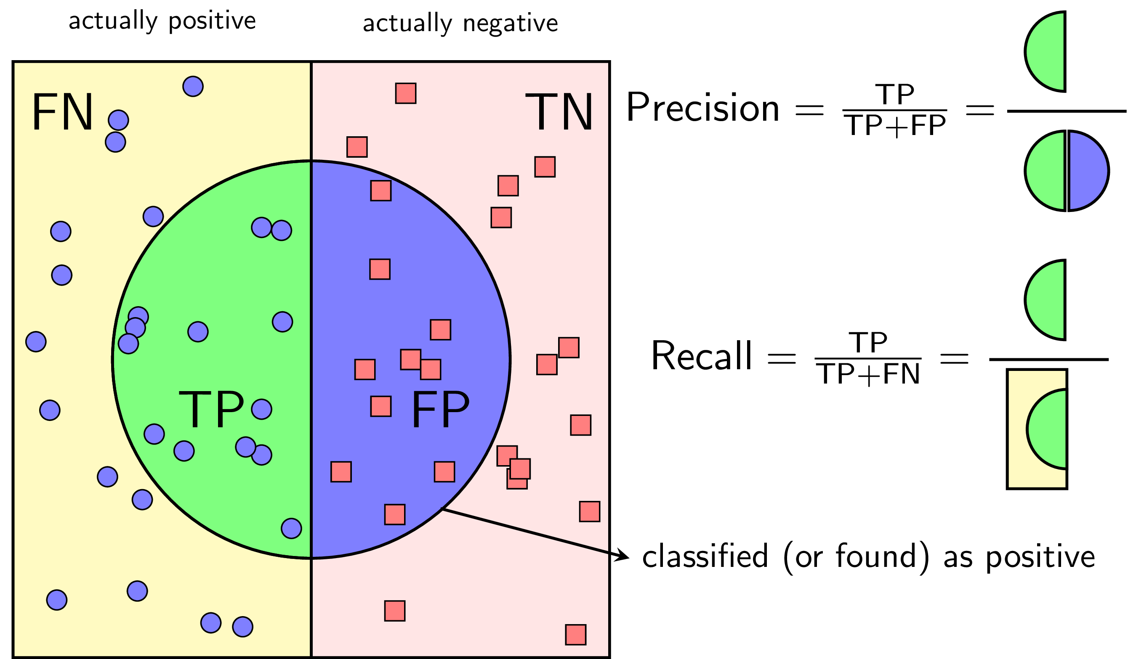
Precision & recall

Slide 11
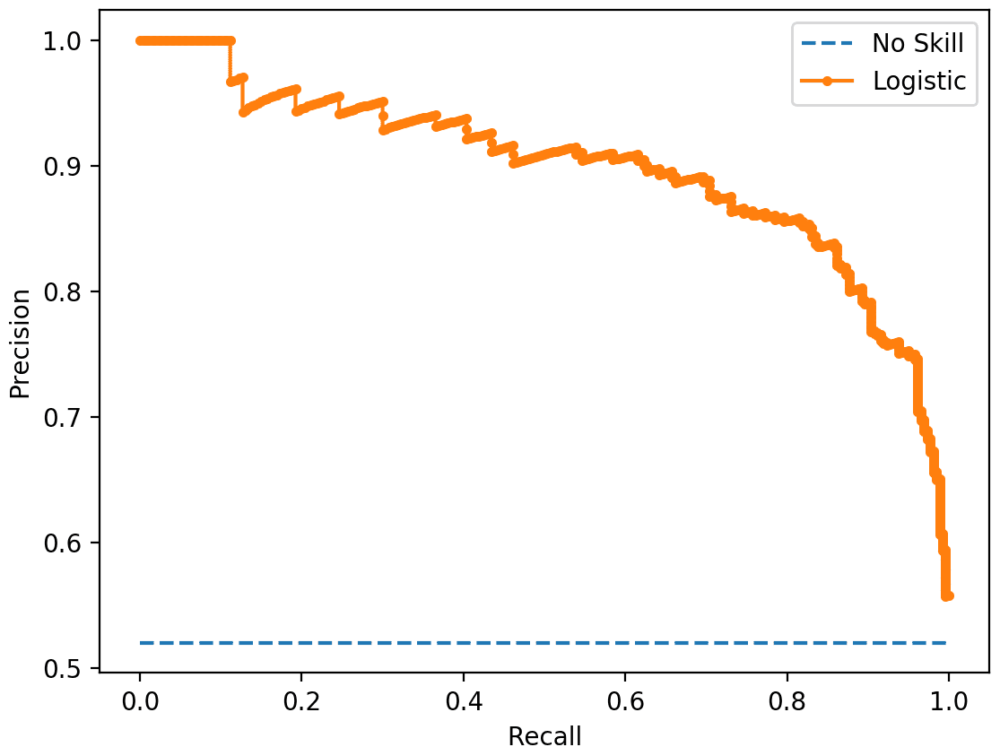
Precision recall curve

Slide 12
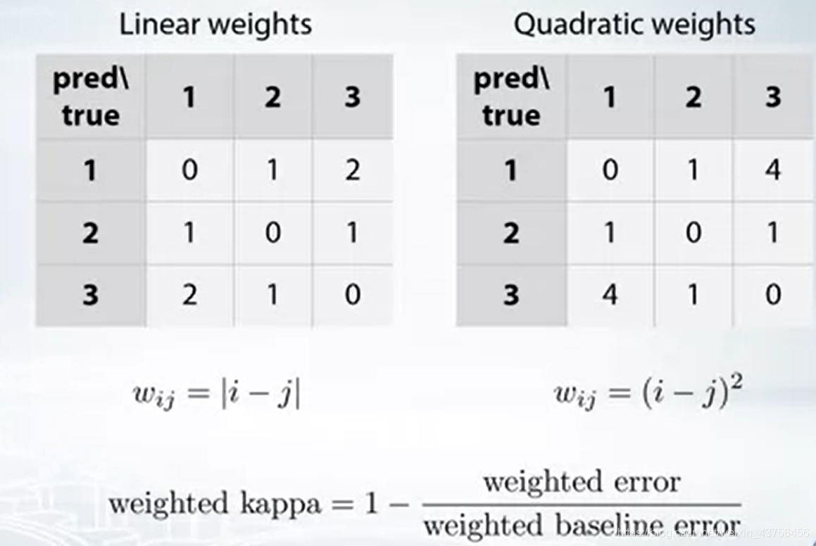
Cohen Kappa

Slide 13
APPROACHING METHOD

Slide 14
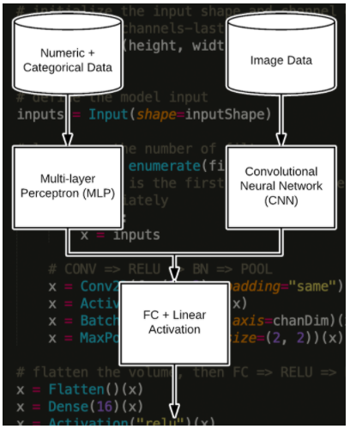
Multiple Inputs
Notes:
https://www.pyimagesearch.com/2019/02/04/keras-multiple-inputs-and-mixed-data/

Slide 15
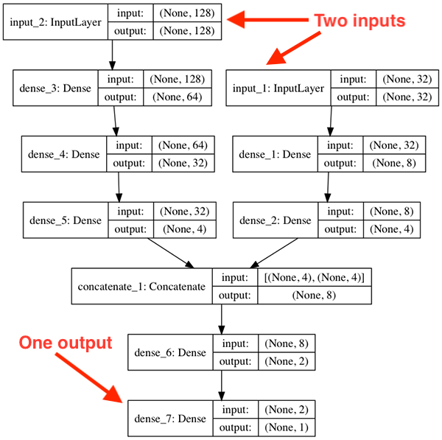
Multiple Inputs

Slide 16
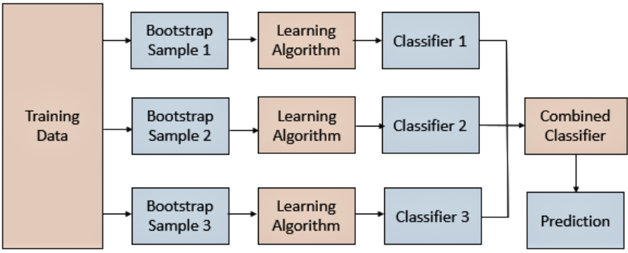
Bagging

Slide 17
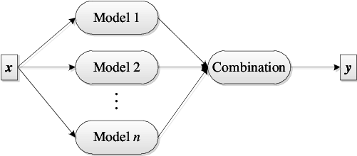
Ensemble model

Slide 18
TABULAR DATA

Slide 19
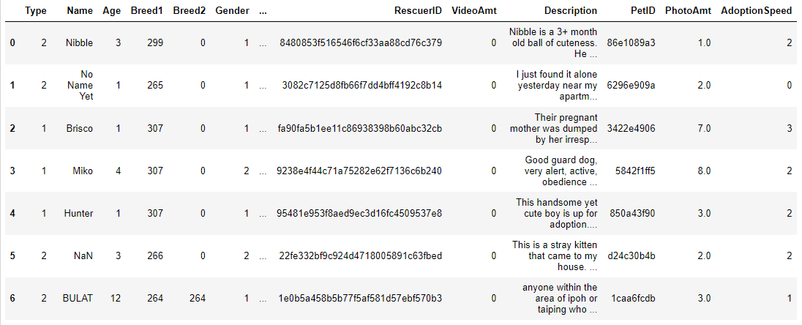
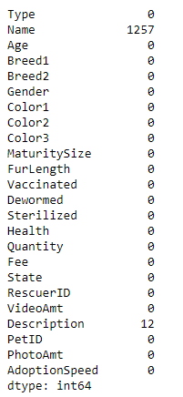
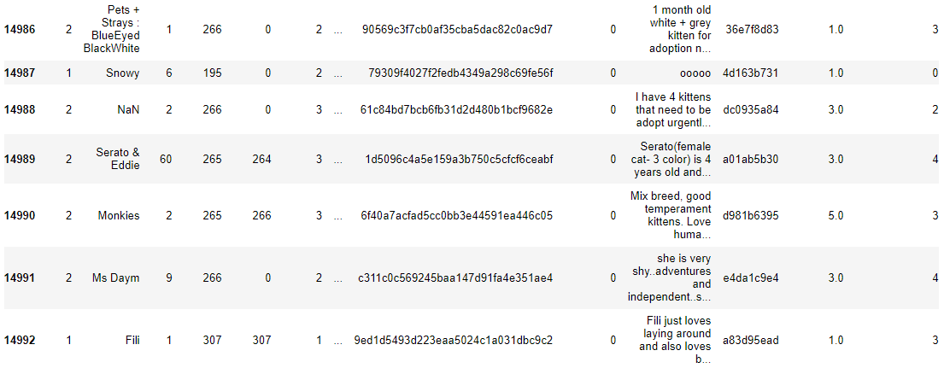
Overall
Null value

Slide 20
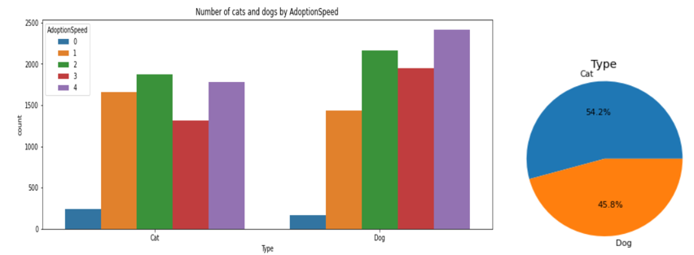
Type

Slide 21
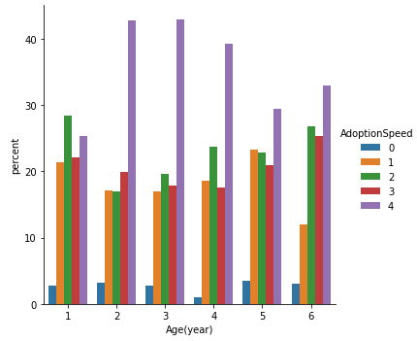
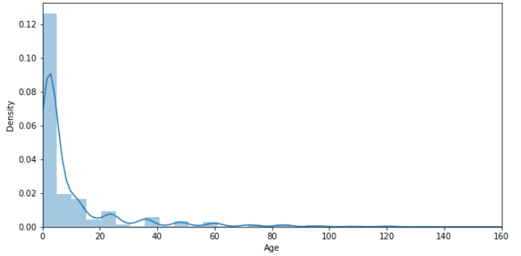
Age

Slide 22
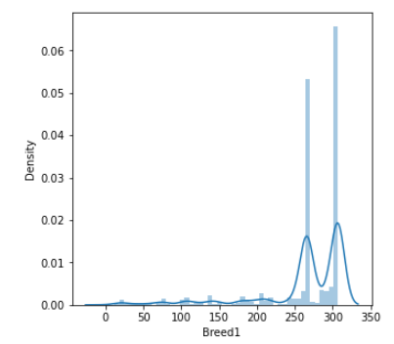
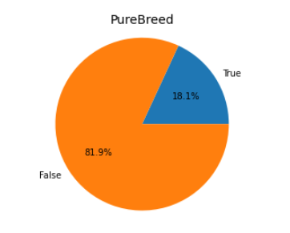
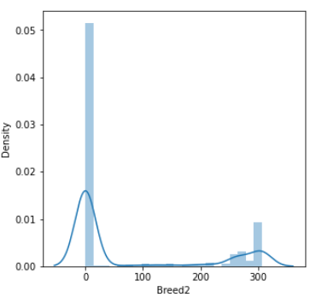
Breed

Slide 23
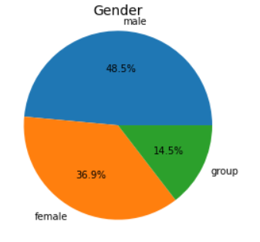
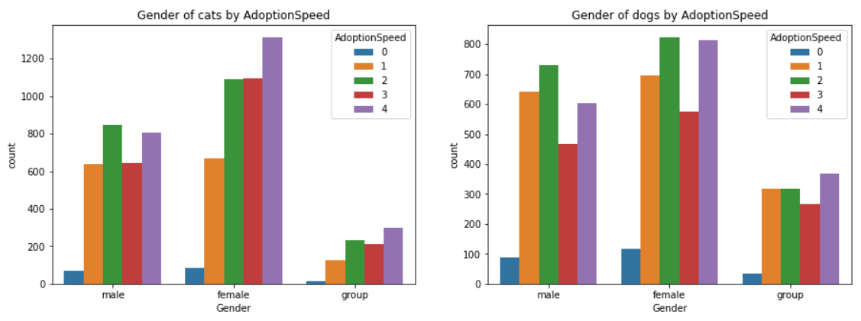
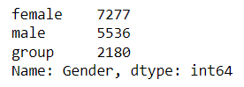
Gender

Slide 24
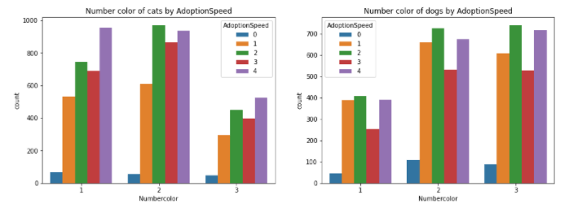
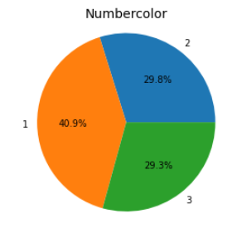
Color

Slide 25
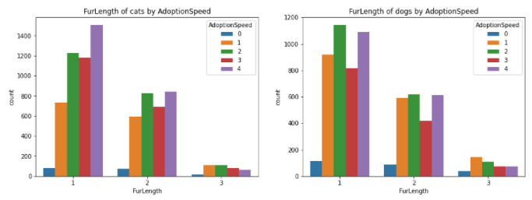
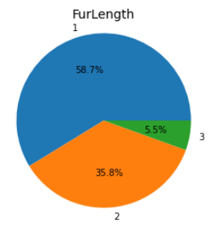
FurLength

Slide 26
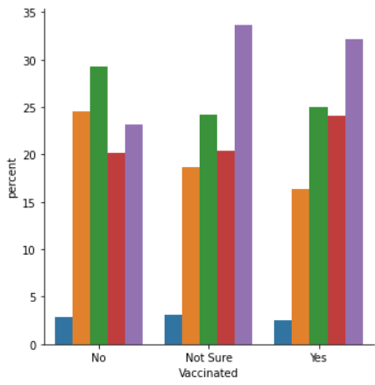
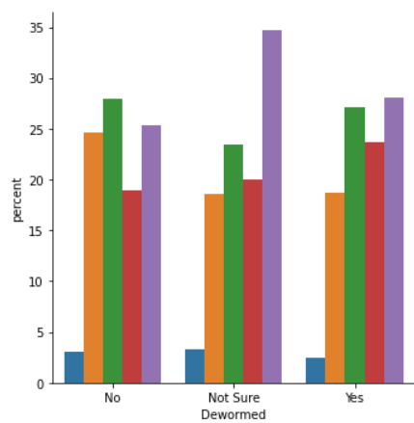
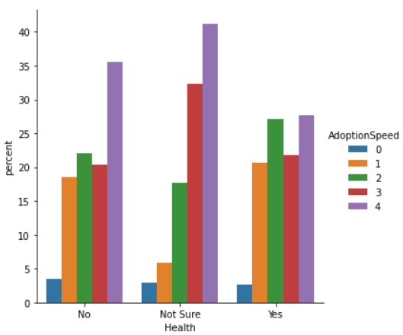
Medical

Slide 27
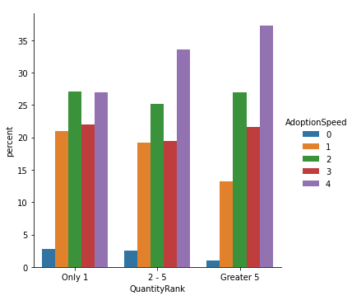
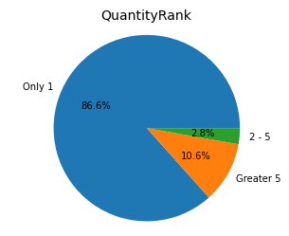
Quantity

Slide 28
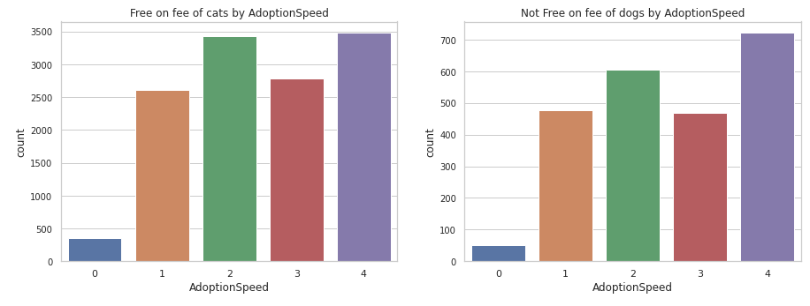
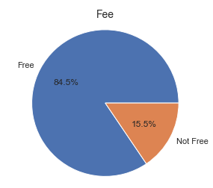
Fee

Slide 29
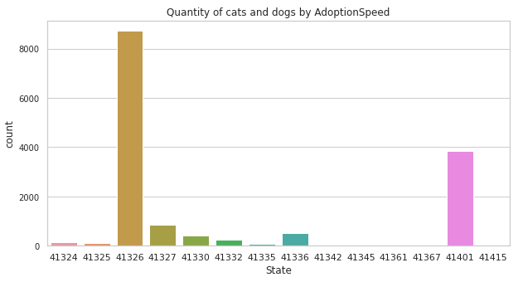
State

Slide 30
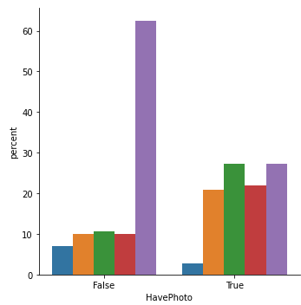
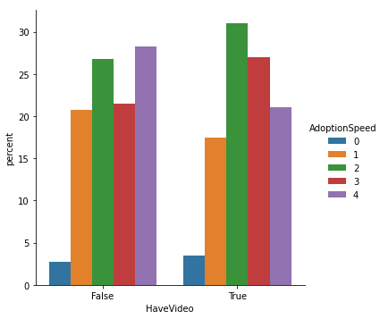
Media File

Slide 31
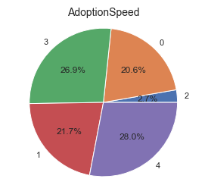
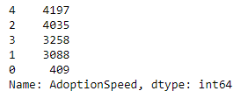
AdoptionSpeed

Slide 32
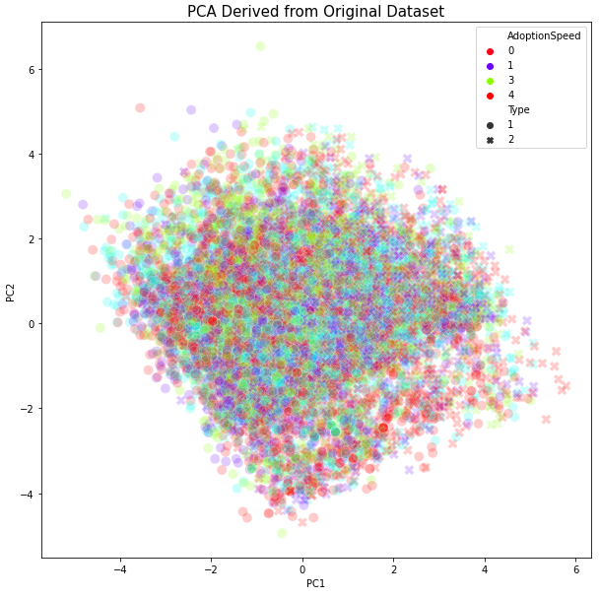
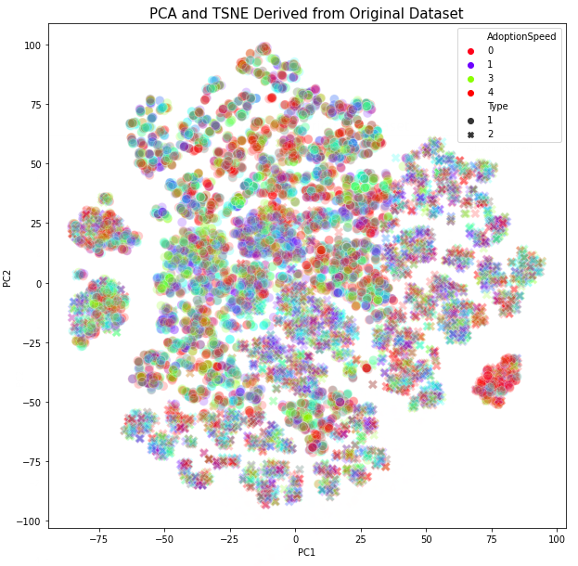
PCA Visualization

Slide 33
IMAGE DATA

Slide 34
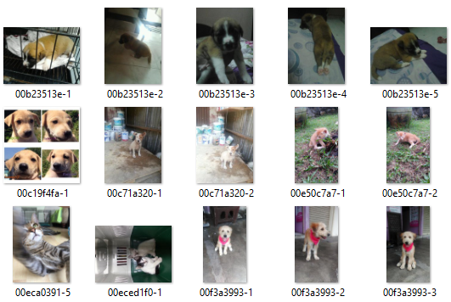
Overall

Slide 35
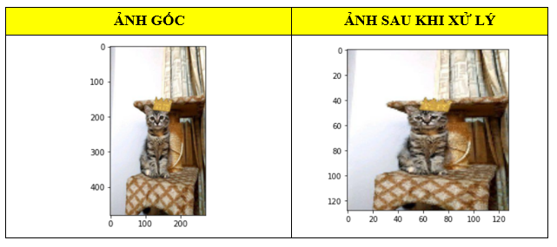
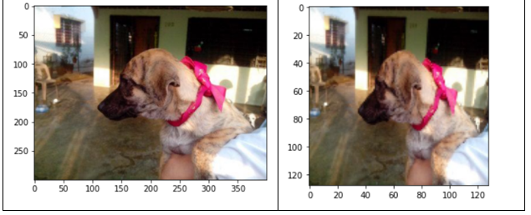
Image processing - Resize

Slide 36
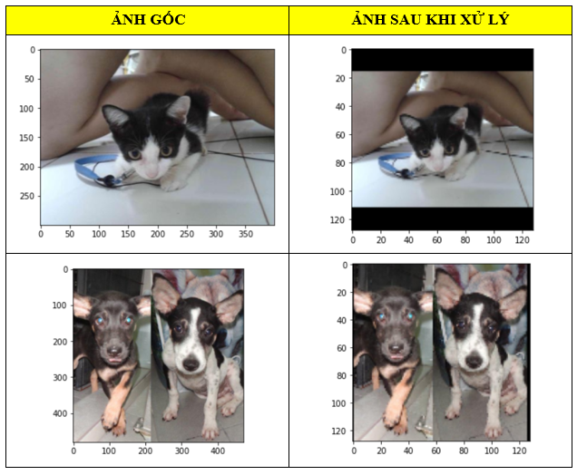
Image processing – Resize + Padding

Slide 37
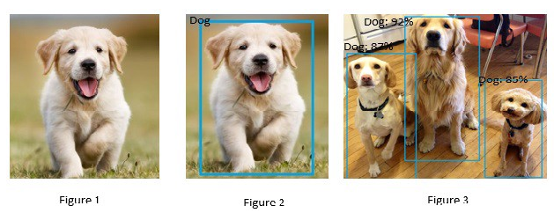
Image processing – Crop resize
OpenCV Object detection with ssd_mobilenet_v3 on COCO dataset

Slide 38
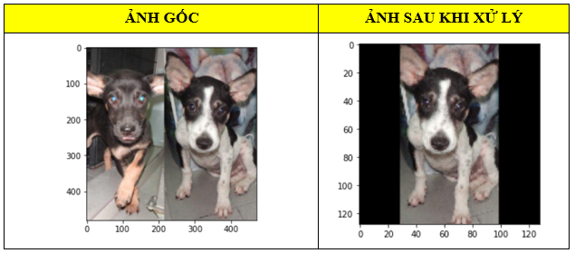
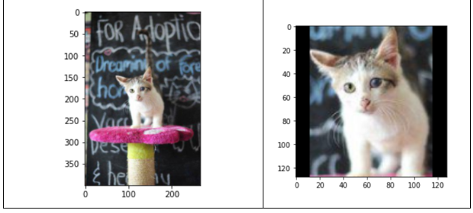
Image processing – Crop resize

Slide 39
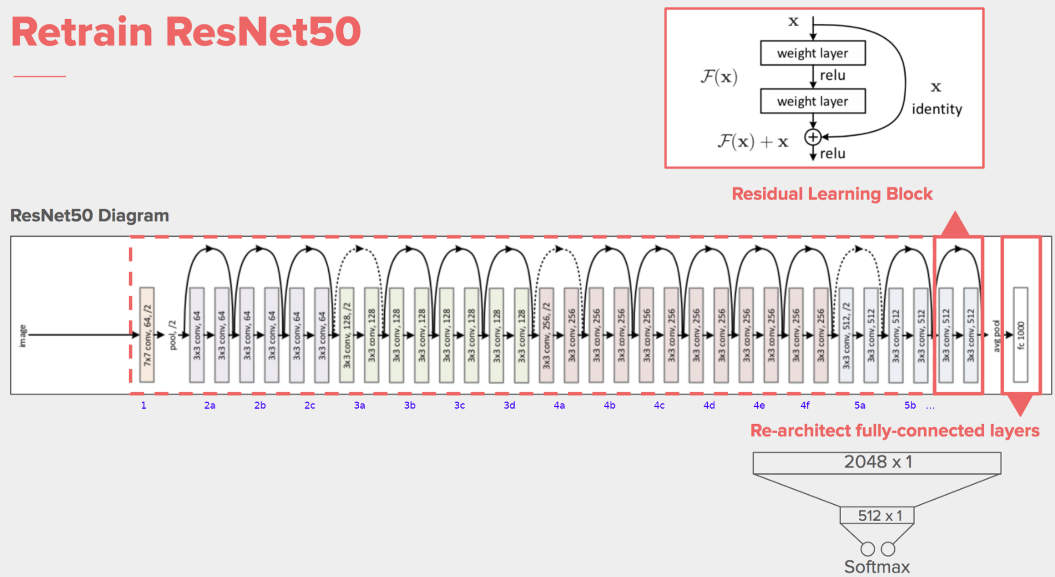
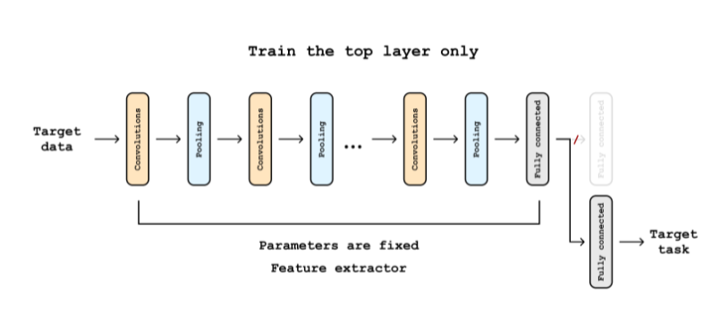
TranferLearning – Resnet50

Slide 40


TranferLearning – Training

Slide 41
DESCRIPTION DATA

Slide 42


Slide 43

N-Gram

Slide 44

Keyword extraction

Slide 45


Tf-idf

Slide 46

Top words in Description

Slide 47

Top words in Name

Slide 48


Name

Slide 49

Pets have no descriptions

Slide 50

DescriptonWordsCount and AdoptionSpeed

Slide 51

TF-IDF

Slide 52


TF-IDF

Slide 53
METADATA

Slide 54


Label detection

Slide 55

Label detection

Slide 56


Image properties

Slide 57

Dominant color

Slide 58

Face detection

Slide 59

Face detection

Slide 60

Text detection

Slide 61


Crop hints

Slide 62
SENTIMENT

Slide 63

Sentiment
Notes:
https://cloud.google.com/natural-language/docs/basics#interpreting_sentiment_analysis_values

Slide 64

Description language

Slide 65

Description entity

Slide 66
MODEL

Slide 67

Support vector machine

Slide 68

Random forest

Slide 69

Gradient Boosting

Slide 70

Ensemble

Slide 71
EVALUATION

Slide 72

Train test split

Slide 73

cross validation

Slide 74

Final result

Slide 75
THANK YOU

